Slide 1
FOCUSED STRATEGIES FOR TEACHERS AND PARENTS
By Quratulain Noor

Slide 2


Slide 3
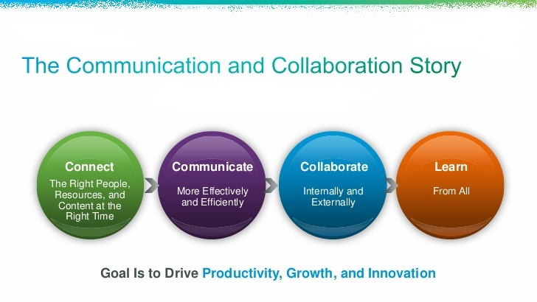

Slide 4


Slide 5


Slide 6
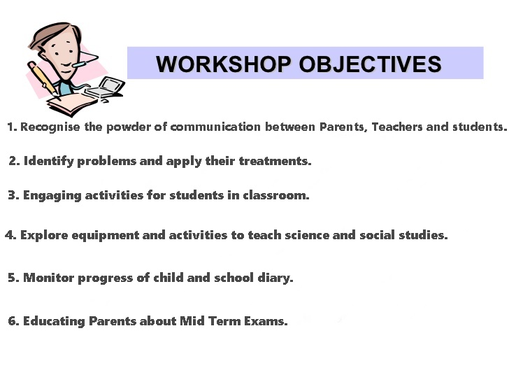

Slide 7
Recognize the Power of
Communication Between Parents and Teachers

Slide 8
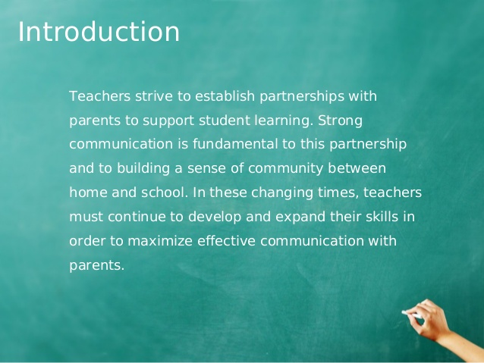

Slide 9
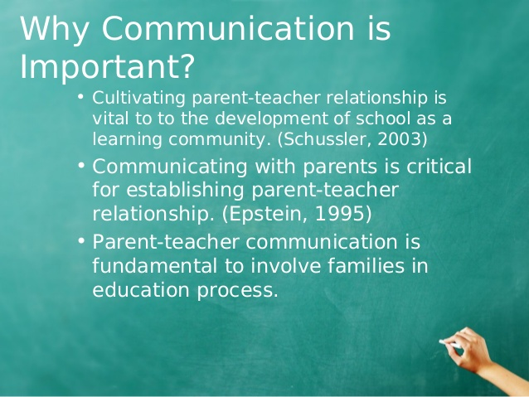

Slide 10
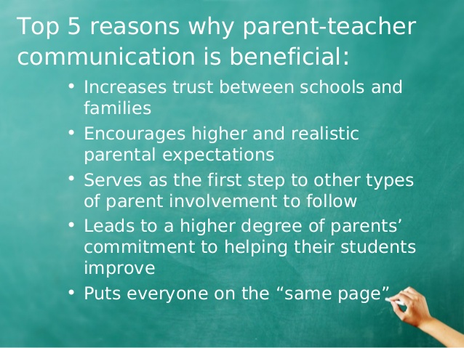

Slide 11
Identify Problems and apply their Treatments.

Slide 12
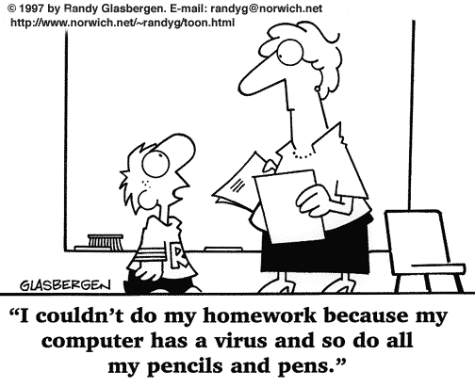

Slide 13


Slide 14
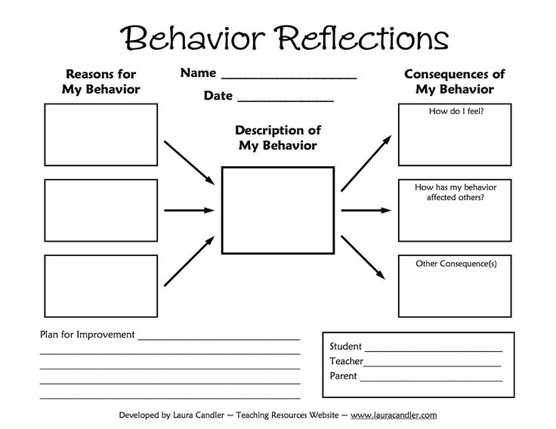

Slide 15
Engaging Activites for Students In Classroom

Slide 16


Slide 17
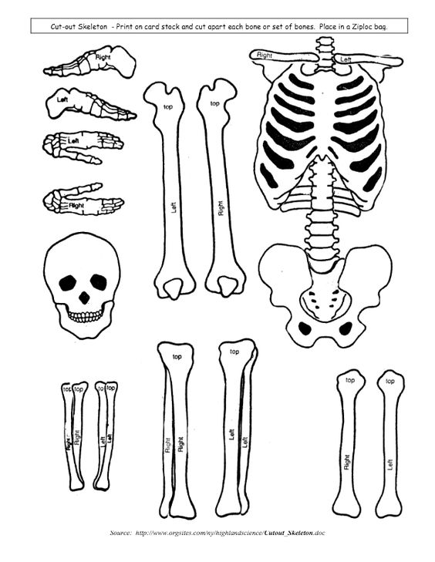

Slide 18
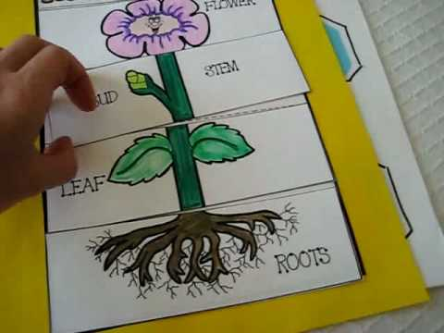

Slide 19
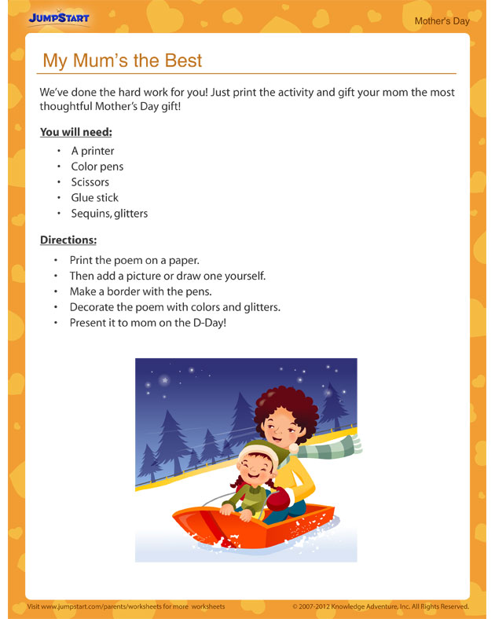

Slide 20
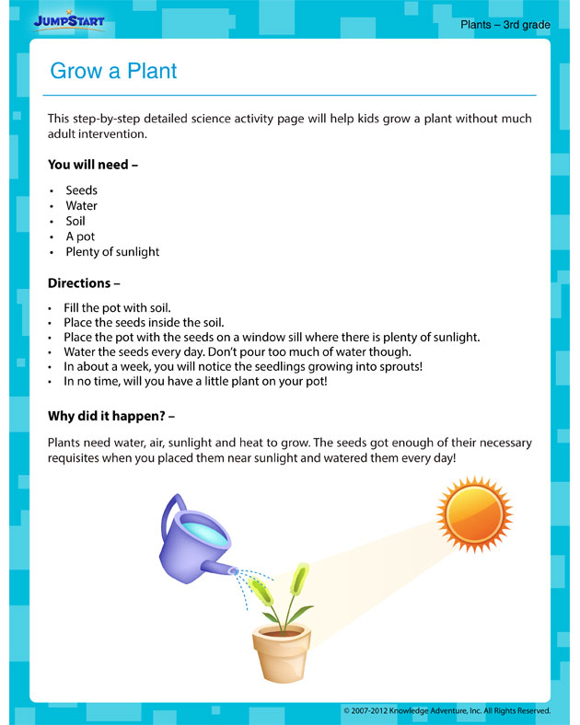

Slide 21
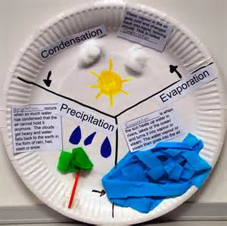

Slide 22
Monitor Progress of Child and Diary

Slide 23
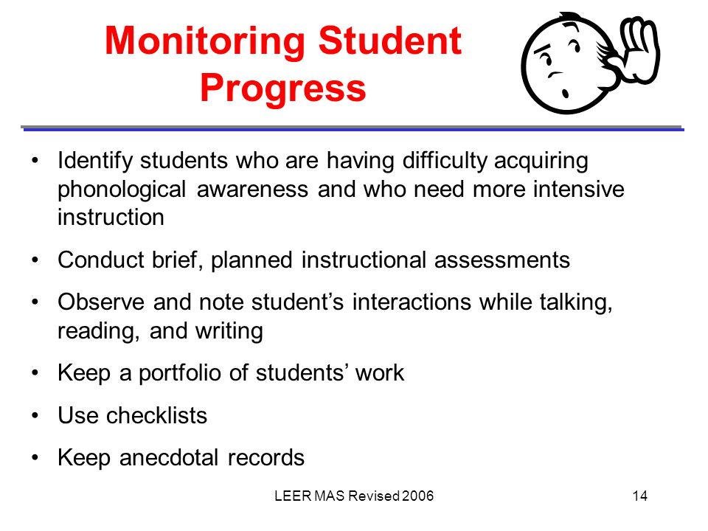

Slide 24


Slide 25


Slide 27


Slide 28
Thank You For your Time.

